Slide 1

INSTITUTE UIE
DEPARTMENT ACADEMIC UNIT-1
Bachelor of Engineering (Computer Science & Engineering)
Subject Name Semi Conductor Physics
Subject Code 23SPH-143
Prepared By
Navjeet Kaur
Experiment-2.1.5
Introduction to FET & MOSFET and its Applications.
DISCOVER . LEARN . EMPOWER

Slide 2
Content
Types of Field Effect Transistors
Junction Field Effect Transistor (JFET)
Constructional Details
Schematic Symbol of JFET
Introduction MOSFET
Applications of MOSFET

Slide 3
Types of Field Effect Transistors
A bipolar junction transistor (BJT) is a current controlled device i.e., output characteristics of the device are controlled by base current and not by base voltage.
However, in a field effect transistor (FET), the output characteristics are controlled by input voltage (i.e., electric field) and not by input current.
There are two basic types of field effect transistors:
(i) Junction field effect transistor (JFET)
(ii) Metal oxide semiconductor field effect transistor (MOSFET)

Slide 4
Junction Field Effect Transistor (JFET)
A junction field effect transistor is a three terminal semiconductor device in which current conduction is by one type of carrier i.e., electrons or holes.
Constructional details
A JFET consists of a p-type or n-type silicon bar containing two pn junctions at the sides as shown in Fig. 1.
The bar forms the conducting channel for the charge carriers. If the bar is of n-type, it is called n-channel JFET as shown in Fig. (i) and if the bar is of p-type, it is called a p-channel JFET as shown in Fig. (ii).
The two pn junctions forming diodes are connected internally and a common terminal called gate is taken out. Other terminals are source and drain taken out from the bar as shown. Thus a JFET has essentially three terminals viz., gate (G), source (S) and drain (D).

Slide 5
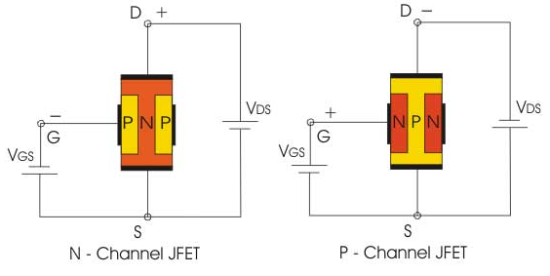
Constructional Details
Fig-1 Constructional Details
Source:https://www.polytechnichub.com/wp-content/uploads/2017/04/biasing-of-jfet.jpg
Notes:
Source:https://www.polytechnichub.com/wp-content/uploads/2017/04/biasing-of-jfet.jpg

Slide 6
Schematic Symbol of JFET
Fig. shows the schematic symbol of JFET. The vertical line in the symbol may be thought channel is n-type, the arrow on the gate points towards the channel as shown in Fig. (i).
However, for p-type channel, the arrow on the gate points from channel to gate .
Fig-2 Symbol of JFET
Source:http://www.circuitstoday.com/wp-content/uploads/2009/08/n-channel-p-channel-jfet.jpg
Notes:
Source:http://www.circuitstoday.com/wp-content/uploads/2009/08/n-channel-p-channel-jfet.jpg

Slide 7
JFET polarities
Fig. (i) shows n-channel JFET polarities whereas
Fig. (ii) shows the p-channel JFET polarities. Note that in each case, the voltage between the gate and source is such that the gate is reverse biased.
Fig-3 JFET polarities
Source:https://www.polytechnichub.com/wp-content/uploads/2017/04/biasing-of-jfet.jpg
Notes:
Source:https://www.polytechnichub.com/wp-content/uploads/2017/04/biasing-of-jfet.jpg

Slide 8
JFET polarities
The following points may be noted :
(i) The input circuit (i.e. gate to source) of a JFET is reverse biased. This means that the device has high input impedance.
(ii) The drain is so biased w.r.t. source that drain current ID flows from the source to drain.
(iii) In all JFETs, source current IS is equal to the drain current i.e. IS = ID.

Slide 9
Difference Between JFET and Bipolar Transistor
In a JFET, there is only one type of carrier, holes in p-type channel and electrons in n-type channel. For this reason, it is also called a unipolar transistor. However, in an ordinary transistor, both holes and electrons play part in conduction. Therefore, an ordinary transistor is sometimes called a bipolar transistor.
As the input circuit (i.e., gate to source) of a JFET is reverse biased, therefore, the device has high input impedance. However, the input circuit of an ordinary transistor is forward biased and hence has low input impedance.
The primary functional difference between the JFET and the BJT is that no current (actually, a very, very small current) enters the gate of JFET (i.e. IG = 0A). However, typical BJT base current might be a few μA while JFET gate current a thousand times smaller.

Slide 10
Difference Between JFET and Bipolar Transistor
A bipolar transistor uses a current into its base to control a large current between collector and emitter whereas a JFET uses voltage on the ‘gate’ ( = base) terminal to control the current between drain (= collector) and source ( = emitter).
Thus a bipolar transistor gain is characterized by current gain whereas the JFET gain is characterized as a transconductance i.e., the ratio of change in output current (drain current) to the input (gate) voltage. (v) In JFET, there are no junctions as in an ordinary transistor. The conduction is through an n- type or p-type semi-conductor material. For this reason, noise level in JFET is very small.

Slide 11
Principle and Working of JFET
Principle. The two pn junctions at the sides form two depletion layers. The current conduction by charge carriers (i.e. free electrons in this case) is through the channel between the two depletion layers and out of the drain.
The width and hence resistance of this channel can be controlled by changing the input voltage VGS. The greater the reverse voltage VGS, the wider will be the depletion layers and narrower will be the conducting channel.
The narrower channel means greater resistance and hence source to drain current decreases. Reverse will happen should VGS decrease. Thus JFET operates on the principle that width and hence resistance of the conducting channel can be varied by changing the reverse voltage VGS. In other words, the magnitude of drain current (ID) can be changed by altering VGS.

Slide 12
Working of JFET
Fig-4 Working of JFET
Source:https://www.polytechnichub.com/wp-content/uploads/2017/04/biasing-of-jfet.jpg
Notes:
Source:https://www.polytechnichub.com/wp-content/uploads/2017/04/biasing-of-jfet.jpg

Slide 13
Working of JFET
(i) When a voltage VDS is applied between drain and source terminals and voltage on the gate is zero [Fig. (i) ], the two pn junctions at the sides of the bar establish depletion layers.
The electrons will flow from source to drain through a channel between the depletion layers. The size of these layers determines the width of the channel and hence the current conduction through the bar.
(ii) When a reverse voltage VGS is applied between the gate and source [Fig. (ii)], the width of the depletion layers is increased. This reduces the width of conducting channel, thereby increasing the resistance of n-type bar.
Consequently, the current from source to drain is decreased. On the other hand, if the reverse voltage on the gate is decreased, the width of the depletion layers also decreases. This increases the width of the conducting channel and hence source to drain current.

Slide 14
Important Terms
In the analysis of a JFET circuit, the following important terms are often used :
Shorted-gate drain current (IDSS)
2. Pinch off voltage (VP)
3. Gate-source cut off voltage [VGS (off)]

Slide 15
APPLICATION OF JFET AS AMPILFIER
Low-Noise Amplifier
Differential Amplifier
Constant Current Source
Analogue Switch or Gate
Voltage Controlled Resistor

Slide 16
MOSFET
FETs have a few disadvantages like high drain resistance, moderate input impedance and slower operation.
To overcome these disadvantages, the MOSFET which is an advanced FET is invented.
MOSFET stands for Metal Oxide Silicon Field Effect Transistor or Metal Oxide Semiconductor Field Effect Transistor.
This is also called as IGFET meaning Insulated Gate Field Effect Transistor. The FET is operated in both depletion and enhancement modes of operation.

Slide 17
Types of MOSFETs
There are two basic types of MOSFETs:
Depletion-type MOSFET or D-MOSFET : The D-MOSFET can be operated in both the depletion- mode and the enhancement-mode. For this reason, a D-MOSFET is sometimes called depletion/enhancement MOSFET.
2. Enhancement-type MOSFET or E-MOSFET : The E-MOSFET can be operated only in enhancement-mode.

Slide 18
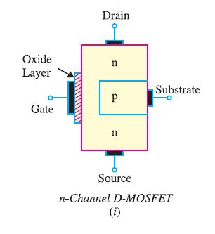
Symbols for D-MOSFET
There are two types of D-MOSFETs.
(i) n-channel D-MOSFET and
(ii) p-channel D-MOSFET.
(i) n-channel D-MOSFET. Fig. 3(i) shows the various parts of n-channel D-MOSFET.
The p-type substrate constricts the channel between the source and drain so that only a small passage remains at the left side. Electrons flowing from source (when drain is positive w.r.t. source) must pass through this narrow channel.
Fig.3: n-Channel E-MOSFET
Source: V K Mehta , Rohit Mehta "Principles of Electronics" 12/e , S. Chand Publishing

Slide 19
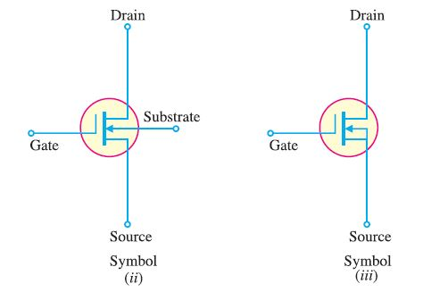
Symbols for n-channel D-MOSFET
The symbol for n-channel D-MOSFET is shown in Fig. 4.
The gate appears like a capacitor plate. Just to the right of the gate is a thick vertical line representing the channel. The drain lead comes out of the top of the channel and the source lead connects to the bottom.
The arrow is on the substrate and points to the n-material, therefore we have n-channel DMOSFET.
It is a usual practice to connect the substrate to source internally as shown in Fig. 4 (iii). This gives rise to a three-terminal device.
Fig.4: n-Channel E-MOSFET
Source: V K Mehta , Rohit Mehta "Principles of Electronics" 12/e , S. Chand Publishing

Slide 20
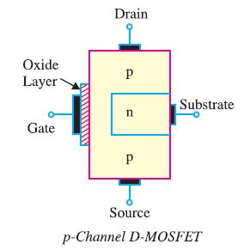
Symbols for p-channel D-MOSFET
(ii) p-channel D-MOSFET. Fig. 5. shows the various parts of p-channel D-MOSFET.
The n-type substrate constricts the channel between the source and drain so that only a small passage remains at the left side. The conduction takes place by the flow of holes from source to drain through this narrow channel.
Fig.5: p-Channel E-MOSFET
Source: V K Mehta , Rohit Mehta "Principles of Electronics" 12/e , S. Chand Publishing

Slide 21
List of the Applications of MOSFET
MOSFET is a voltage controlled device and has some decent applications. There are some advantages of using MOSFET in electronics circuits. Some important applications of MOSFET are given below :
1. MOSFET is used for some switching applications an in electronics device.
2. It is used in some amplifying circuits.
3. It is used in chopper circuits
4. MOSFET can be used as a high-frequency amplifier.
5. It can be used in voltage regulator circuits.
6. It is used as an inverter in some of the electronics circuits.
7. It can be used as a passive element e.g. resistor, inductor used in a circuit.
8. It is used in SMPS ( switch mode power supply ).
9. It is used in some DC brushless motor drives.
10. It is used in DC relay in electronics.
11. It can be used in digital circuits

Slide 22
Summary
Introduction to Types of Field Effect Transistors.
Application Field Effect Transistors.
Different Types of Field Effect Transistors.
Introduction to MOSFET.
Application of MOSFET.

Slide 23
Frequently Asked Questions
What is the difference Between JFET and Bipolar Transistor?
What is the function JFET polarities.
What is the function JFET.
What are the Principle and Working of JFET.

Slide 24

LEARNING OUTCOMES
To make students understand
Concepts of JFET polarities.
Importance of comprehension of JFET and Bipolar Transistor.
Fundamentals of Field Effect Transistors

Slide 25
References
Text Books:
Microelectronics Circuits, Adel S. Sedra and Kenneth Carless Smith, Oxford University Press.
Millman’s Integrated Electronics, Jacob Millman, Christos Halkias, Chetan Parikh, McGraw Hill Education.
Digital Logic & Computer Design, M. Morris Mano, Pearson
Reference Books:
Principles of Electronics, V K Mehta , Rohit Mehta, 12/e , S. Chand Publishing
Solid State Electronic Devices,6th Edition, Ben Streetman, Sanjay Banerjee
Electronic Principle, Albert Paul Malvino.
Electronics Circuits:Discrete & Integrated, D Schilling C BeloveTApelewiczRSaccardi.
Microelectronics, Jacob Millman, Arvin Grabel.
Electronics Devices &Circuits,S. Salivahanan, N. Suresh Kumar,A. Vallavaraj
Electronic Devices & Circuit Theory, 11th Edition, Robert L. Boylestad,LouisNashelsky

Slide 26
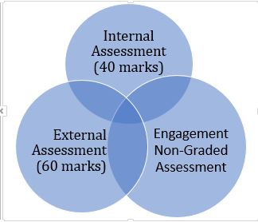

Assessment Pattern

